Slide 1
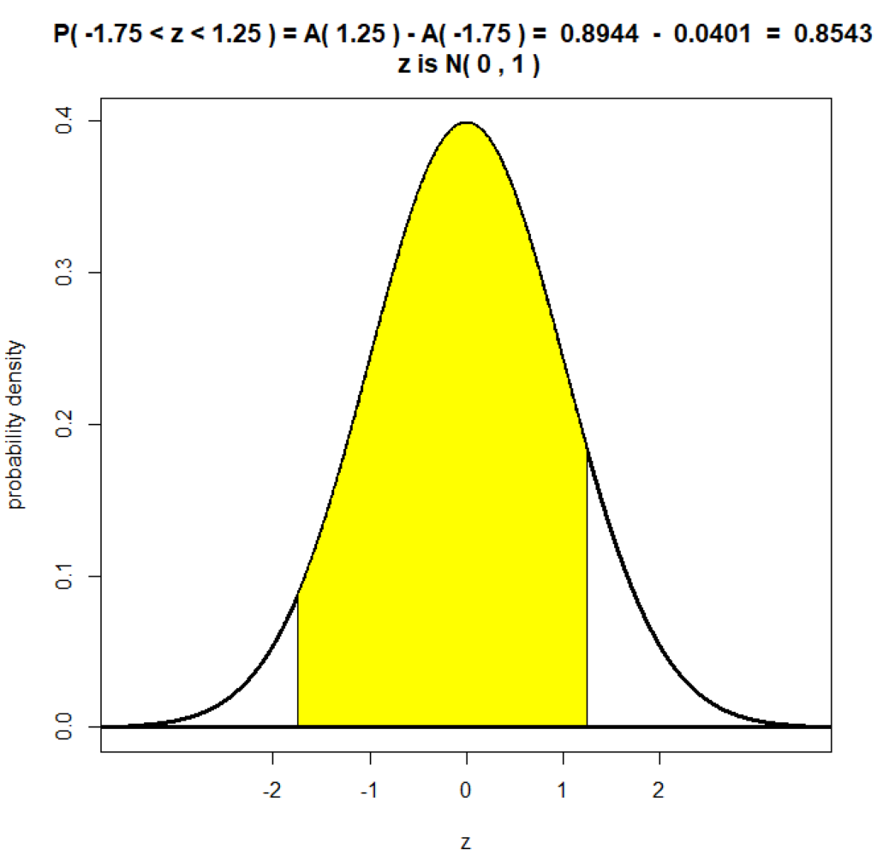
The Normal Distribution
A Level
THE NORMAL DISTRIBUTION
Notes:
Welcome to the unit on ‘Probability: THE NORMAL DISTRIBUTION’

Slide 2
Objectives
The objectives for this session are to:
Understand the normal distribution and its characteristics.
THE NORMAL DISTRIBUTION

Slide 3
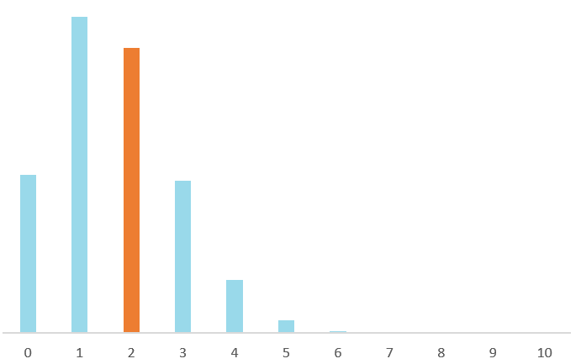
The Normal Distribution
THE NORMAL DISTRIBUTION
Example 1 Illustration
When ten fair dice are rolled, we have:
Discrete Random Variable
$P\left(X=2\right)$ = Probability number of sixes is $2$
A discrete random variable can only take certain distinct values.
Sum of probabilities in a discrete probability distribution is $1$.
Example 1
Suppose ten dice are rolled. Let $X=$ number of sixes.
The variable $X$ is a discrete variable.
$$x$$ | $$0$$ | $$1$$ | $$2$$ | $$3$$ | $$4$$ | $$5$$ | $$6$$ | $$7$$ | $$8$$ | $$9$$ | $$10$$
$$P(X=x)$$ | $$0.162$$ | $$0.323$$ | $$0.291$$ | $$0.155$$ | $$0.054$$ | $$0.013$$ | $$0.002$$ | $$0.000$$ | $$0.000$$ | $$0.000$$ | $$0.000$$

Slide 4
The Normal Distribution
THE NORMAL DISTRIBUTION
Example 2 Illustration
Continuous Random Variable
$P\left(Y<6\right)=$ Probability average surface area is less than $6cm^{2}$
A continuous random variable can take infinitely many values. The probability that this variable takes a specific value is $0$. So we consider a range of values.
$$3$$
$$4$$
$$5$$
$$6$$
Continuous Random Variable
Example 2
A continuous random variable has a continuous probability distribution. We can show this as a curve on a graph.
Area under a continuous probability distribution equals $1$.
Suppose ten dice are rolled. Let $Y=$ average surface area of dice.
$Y$ is a continuous random variable.

Slide 5
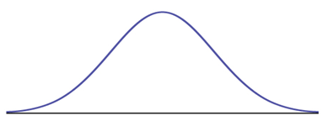
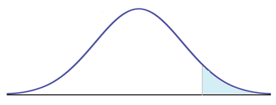
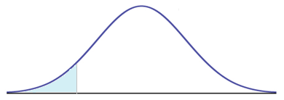
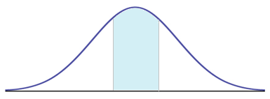
The Normal Distribution
THE NORMAL DISTRIBUTION
Continuous Random Variable
Continuous variables encountered in real life often cluster around a central value.
The normal distribution is a continuous distribution which can be used to model naturally occurring characteristics.
Real Life Examples
Heights: people …
Lengths: animals, objects …
Weights: people, animals, objects …
Size Variations: product sizes and weights …
Errors in Measurements

Slide 6
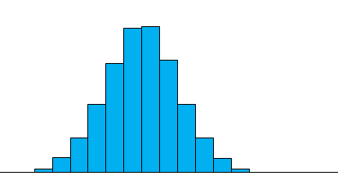
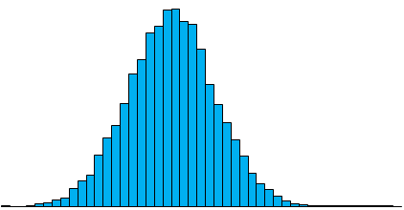
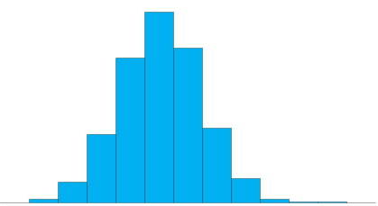
THE NORMAL DISTRIBUTION
Example: The weight of a group of lions
$$f$$
$$f$$
$$f$$
$$0.4$$
$$0.4$$
$$0.4$$
$$0.3$$
$$0.3$$
$$0.3$$
Relative Frequency Density
Relative Frequency Density
Relative Frequency Density
$$0.2$$
$$0.2$$
$$0.2$$
$$0.1$$
$$0.1$$
$$0.1$$
$$0$$
$$x$$
$$0$$
$$x$$
$$0$$
$$x$$
$$150$$
$$160$$
$$170$$
$$180$$
$$190$$
$$200$$
$$210$$
$$220$$
$$230$$
$$150$$
$$160$$
$$170$$
$$180$$
$$190$$
$$200$$
$$210$$
$$220$$
$$230$$
$$150$$
$$160$$
$$170$$
$$180$$
$$190$$
$$200$$
$$210$$
$$220$$
$$230$$
Weight (kg)
Weight (kg)
Weight (kg)
As class width becomes narrower, the distribution gets smoother.

Slide 7
THE NORMAL DISTRIBUTION
Example: The weight of a group of lions
$$f$$
$$f$$
$$f$$
$$0.4$$
$$0.4$$
$$0.4$$
$$0.3$$
$$0.3$$
$$0.3$$
Relative Frequency Density
Relative Frequency Density
Relative Frequency Density
$$0.2$$
$$0.2$$
$$0.2$$
$$0.1$$
$$0.1$$
$$0.1$$
$$0$$
$$0$$
$$0$$
$$x$$
$$x$$
$$230$$
$$x$$
$$230$$
$$150$$
$$230$$
$$150$$
$$150$$
$$220$$
$$220$$
$$210$$
$$220$$
$$210$$
$$160$$
$$210$$
$$160$$
$$160$$
$$200$$
$$200$$
$$170$$
$$200$$
$$170$$
$$170$$
$$180$$
$$180$$
$$180$$
$$190$$
$$190$$
$$190$$
Weight (kg)
Weight (kg)
Weight (kg)
As class width becomes narrower, the distribution gets smoother.

Slide 8
THE NORMAL DISTRIBUTION
Example: The weight of a group of lions
$$f$$
Probability Density
$$150$$
$$160$$
$$170$$
$$180$$
$$190$$
$$200$$
$$210$$
$$220$$
$$230$$
$$x$$
Weight (kg)
As class width becomes narrower, the distribution gets smoother.

Slide 9
THE NORMAL DISTRIBUTION
SMALL $σ$
$$y$$
$μ=$Mean
$$y$$
$$y$$
BIG $σ$
$μ=$Mean
$μ=$Mean
Probability Density
Probability Density
Probability Density
$$μ$$
$$x$$
$$μ$$
$$x$$
$$μ$$
$$x$$
Weight (kg)
Weight (kg)
Weight (kg)
Recall: Standard Deviation $σ$ gives an indication of how spread out the data is around the mean.
The larger the standard deviation is, the more spread out the data will be.

Slide 10
THE NORMAL DISTRIBUTION
$$y$$
$μ=$Mean
Probability Density
$$μ$$
$$μ+3σ$$
$$x$$
$$μ−3σ$$
$$μ−2σ$$
$$μ−σ$$
$$μ+σ$$
$$μ+2σ$$
Weight (kg)
Recall: Standard Deviation gives an indication of how spread out the data is around the mean. The larger the standard deviation is, the more spread out the data will be.

Slide 11
THE NORMAL DISTRIBUTION
Notation
If $X$ is a normally distributed random variable:
$$X\sim N\left(μ,σ^{2}\right)$$
where
$μ=$Mean
$σ=$Standard Deviation
$σ^{2}=$Variance
$$y$$
$μ=$Mean
Probability Density
$$μ$$
$$μ+3σ$$
$$x$$
$$μ−3σ$$
$$μ−2σ$$
$$μ−σ$$
$$μ+σ$$
$$μ+2σ$$
Weight (kg)

Slide 12
THE NORMAL DISTRIBUTION
The Weight of a Group of Lions
Example 4
Let
$$X=$$
$$f$$
If $X$ is a normally distributed random variable:
$$X\sim N\left(μ,σ^{2}\right)$$
where
$μ=$Mean
$σ=$Standard Deviation
$σ^{2}=$Variance
Mean
$$X\sim N\left(190,{13}^{2}\right)$$
Probability Density
$σ=$Standard Deviation
$μ=$Mean
$σ^{2}=$Variance
$$150$$
$$160$$
$$170$$
$$180$$
$$190$$
$$200$$
$$210$$
$$220$$
$$230$$
$$x$$
Weight (kg)

Slide 13
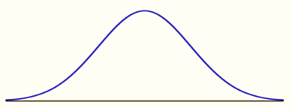
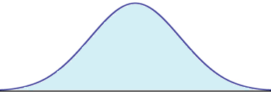
THE NORMAL DISTRIBUTION
Normal distribution is bell-shaped and symmetric about mean.
Asymptotes at each end.
Mean = Mode = Median
Total area under curve $=1$.
Point of inflection at $μ+σ.$
Point of inflection at $μ−σ.$
$$f$$
Mean = Mode = Median
Point of inflection $=μ−σ$
Point of inflection $=μ+σ$
Probability Density
Area $=1$
$$150$$
$$160$$
$$170$$
$$180$$
$$190$$
$$200$$
$$210$$
$$220$$
$$230$$
$$x$$
Weight (kg)

Slide 14
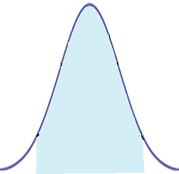
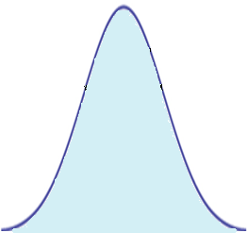
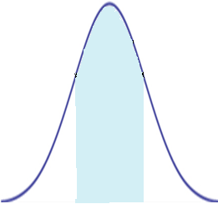
THE NORMAL DISTRIBUTION
For a normally distributed variable, approximately:
$68\%$of data lies within one standard deviation of the mean;
$95\%$of data lies within two standard deviations of the mean;
all or almost all ($99.7\%$) the data lies within three standard deviations of the mean;
$$f$$
Probability Density
$$68\%$$
$$95\%$$
$$99.7\%$$
$$150$$
$$160$$
$$170$$
$$180$$
$$190$$
$$200$$
$$210$$
$$220$$
$$230$$
$$x$$
Weight (kg)

Slide 15
THE NORMAL DISTRIBUTION
Example 4
The Weight of a Group of Lions
$$f$$
Shade:
$P\left(X<170\right)$
$P\left(X>213\right)$
$P\left(185<X<200\right)$
$P\left(X>190\right)$
Probability Density
$$150$$
$$160$$
$$170$$
$$180$$
$$190$$
$$200$$
$$210$$
$$220$$
$$230$$
$$x$$
Weight (kg)

Slide 16
THE NORMAL DISTRIBUTION
Example 4a
The Weight of a Group of Lions
$$f$$
Shade $P\left(X<170\right)$.
Probability Density
$$150$$
$$160$$
$$170$$
$$180$$
$$190$$
$$200$$
$$210$$
$$220$$
$$230$$
$$x$$
Weight (kg)

Slide 17
THE NORMAL DISTRIBUTION
Example 4b
The Weight of a Group of Lions
$$f$$
Shade $P\left(X>213\right)$.
Probability Density
$$150$$
$$160$$
$$170$$
$$180$$
$$190$$
$$200$$
$$210$$
$$220$$
$$230$$
$$x$$
Weight (kg)

Slide 18
THE NORMAL DISTRIBUTION
Example 4c
The Weight of a Group of Lions
$$f$$
Shade $P\left(185<X<200\right)$
Probability Density
$$150$$
$$160$$
$$170$$
$$180$$
$$190$$
$$200$$
$$210$$
$$220$$
$$230$$
$$x$$
Weight (kg)

Slide 19
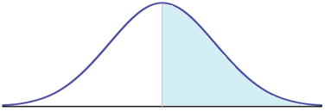
THE NORMAL DISTRIBUTION
Example 4d
The Weight of a Group of Lions
$$f$$
Shade $P\left(X>190\right)$.
Probability Density
$$150$$
$$160$$
$$170$$
$$180$$
$$190$$
$$200$$
$$210$$
$$220$$
$$230$$
$$x$$
Weight (kg)

Slide 20
Recap
If you have understood the content of this session, you should be able to:
Understand the normal distribution and its characteristics.
REVIEW

Slide 21
Exercises
Questions
Now attempt the exercises in your text book related to this topic.
Notes:
Now attempt the exercises in your text book related to this topic.

Slide 22
Copyright
© Z. Ali 2020

